Slide 1


Domain-Specific Languages and Xtext
Mathieu Acher
Maître de Conférences
mathieu.acher@irisa.fr

Slide 2
Material
https://github.com/acherm/teaching-MDE-MIAGE1718

Slide 3
Plan
Domain-Specific Languages (DSLs)
Languages and abstraction gap
Examples and rationale
DSLs vs General purpose languages, taxonomy
External DSLs
Grammar and parsing
Xtext
DSLs, DSMLs, and (meta-)modeling

Slide 4
Contract
Better understanding/source of inspiration of software languages and DSLs
Revisit of history and existing languages
Foundations and practice of Xtext
State-of-the-art language workbench (Most Innovative Eclipse Project in 2010, mature and used in a variety of industries)
Models and Languages
Perhaps a more concrete way to see models, metamodels and MDE (IDM in french)

Slide 5
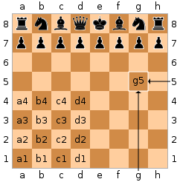
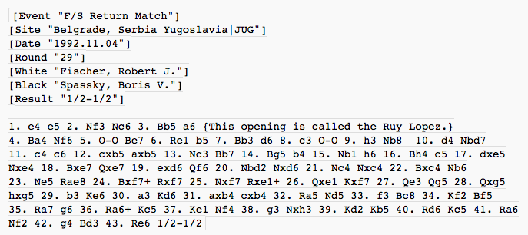





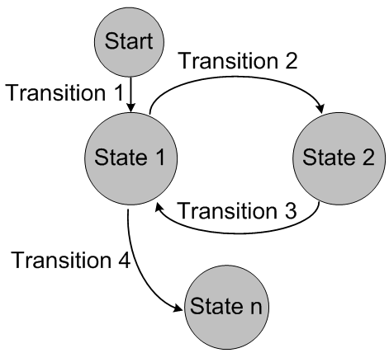


PGN
Graphviz
Make
Matlab
Finite State Machine
Domain-Specific Languages (DSLs)

Slide 6
DSL =
Syntax + Services
Specialized notation:
Textual or Graphical
Specific Vocabulary
Idiomatic constructs
Specialized tools/IDE:
Editor with auto-completion, syntax highlighting, etc.
Compiler
Interpreter
Debugger
Profiler
Syntax/Type Checker
…

Slide 7
Language workbenches
Tools for reducing the gap between the design and implementation of (external) domain-specific languages
The Killer App for DSLs? http://www.martinfowler.com/articles/languageWorkbench.html

Slide 8
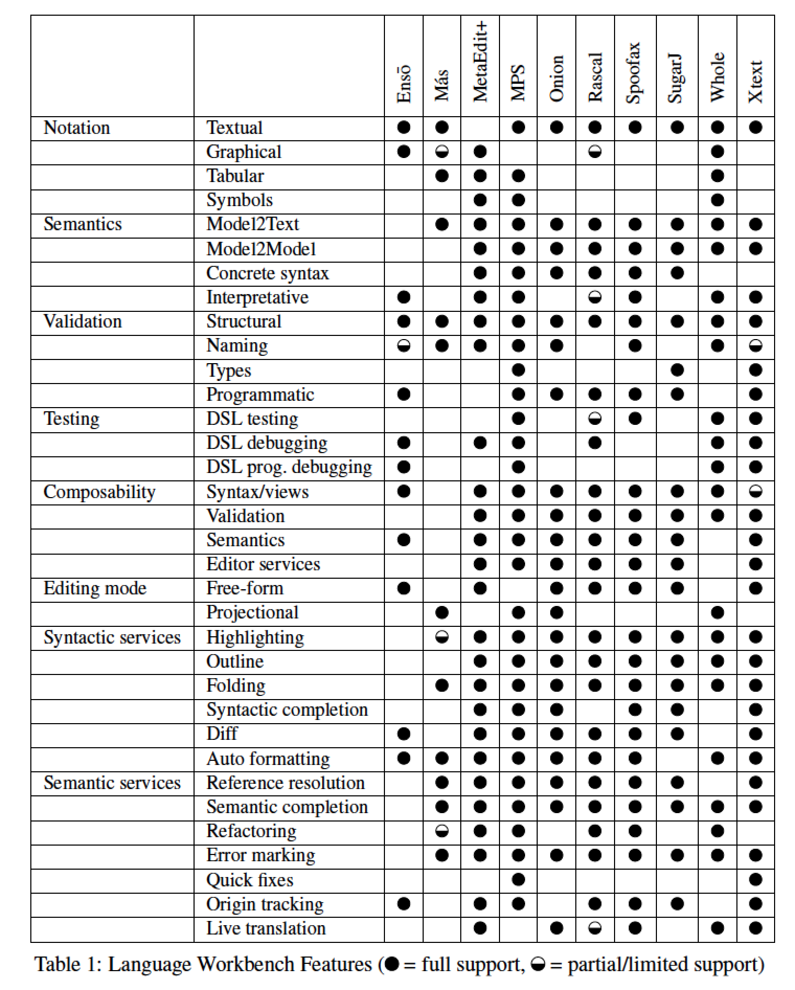
Language Workbenches
Erdweg et al. SLE’13

Slide 9
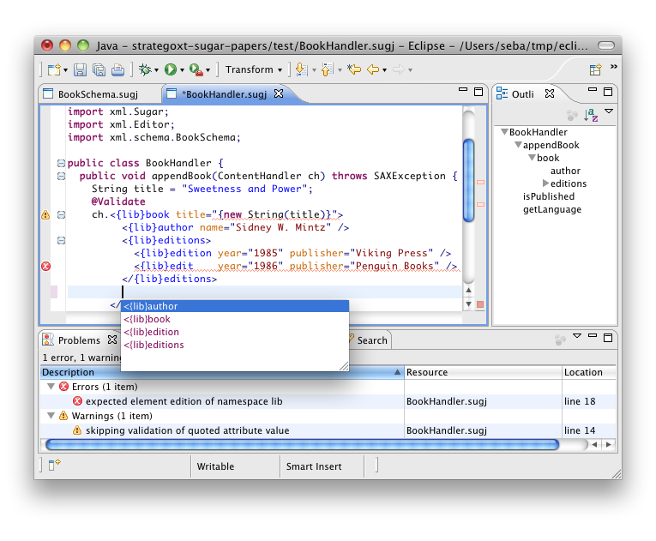
Sebastian Erdweg, Tillmann Rendel, Christian Kästner, and Klaus Ostermann. Sugarj: Library-based syntactic language extensibility. OOPSLA’11

Slide 10
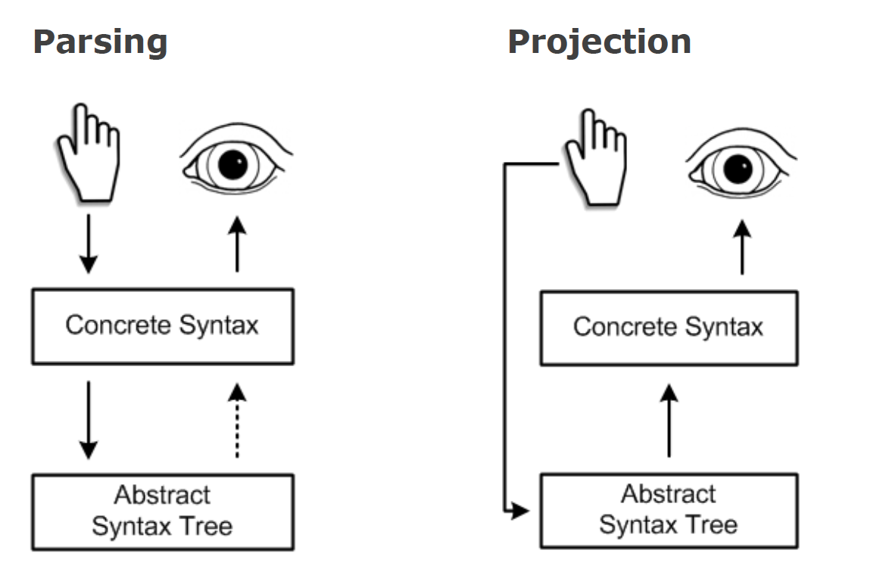
Projectional editing

Slide 11
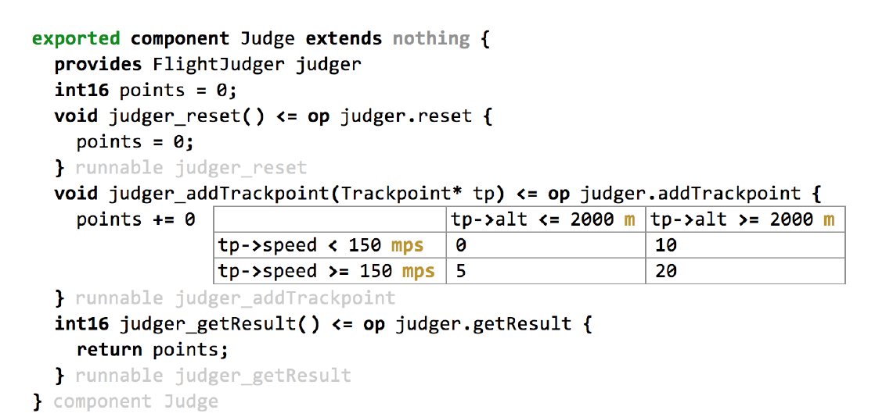
Projectional editing

Slide 12
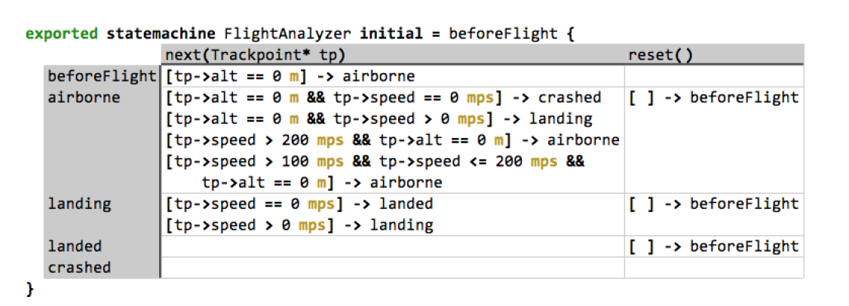
Projectional Editing

Slide 13
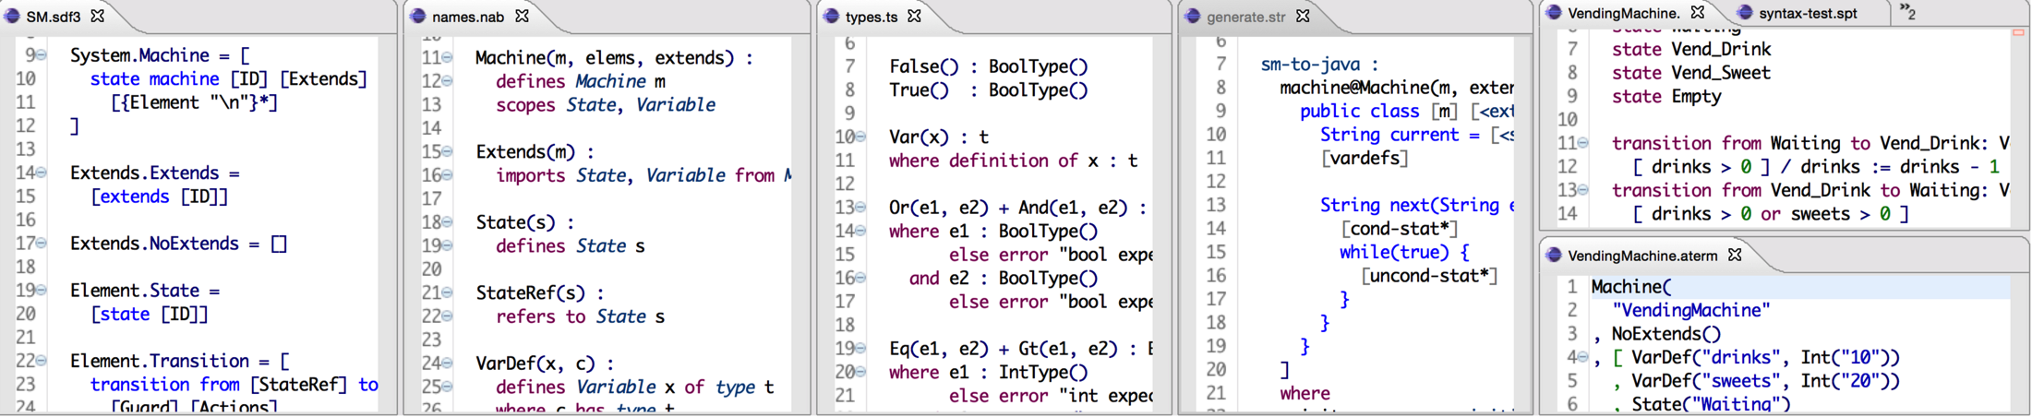
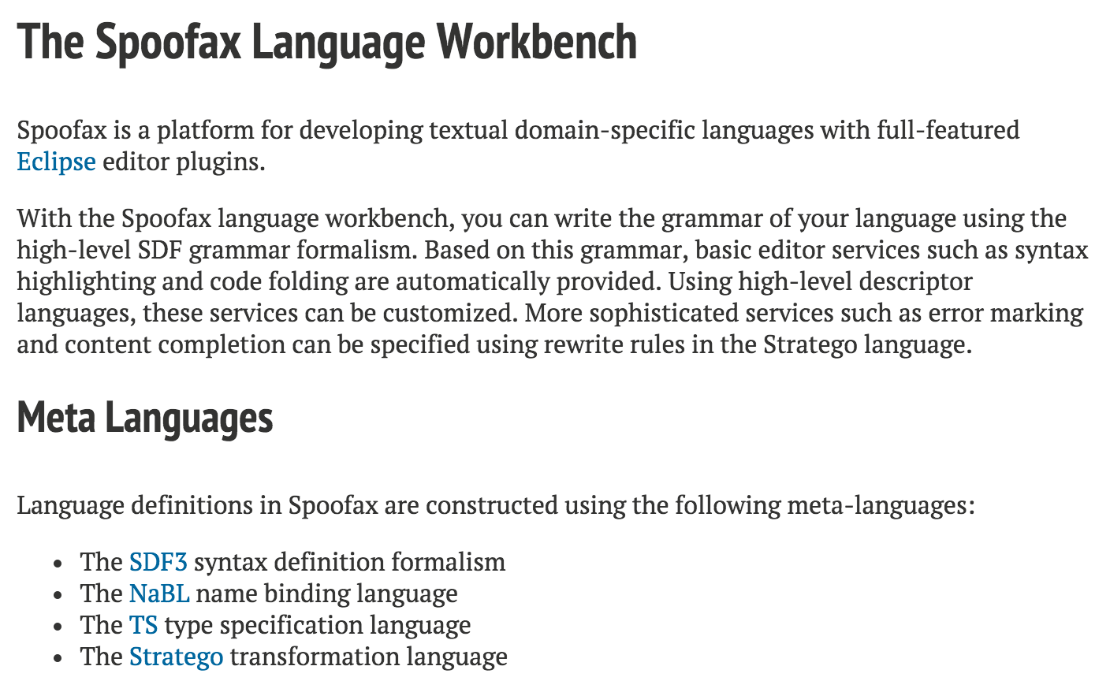
http://metaborg.org/spoofax/#meta-languages

Slide 14


Slide 15
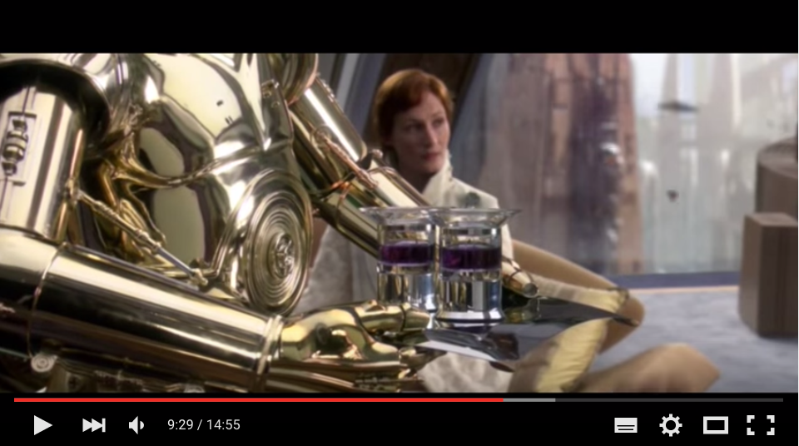
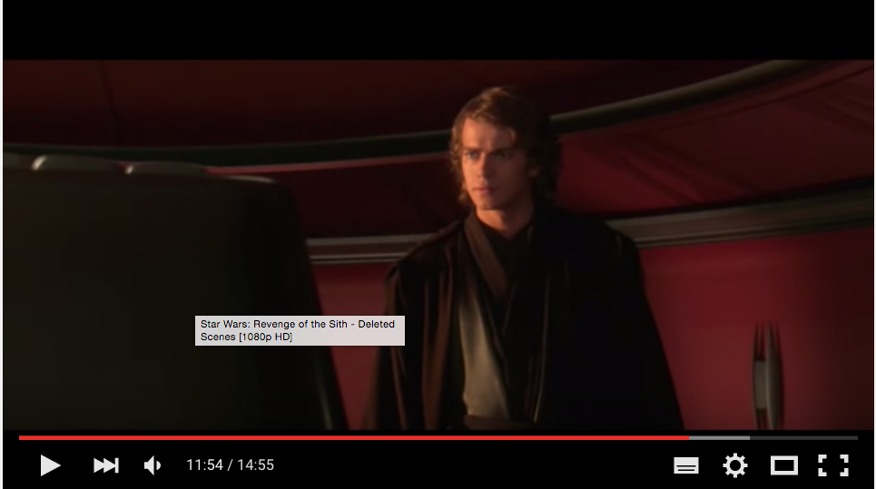
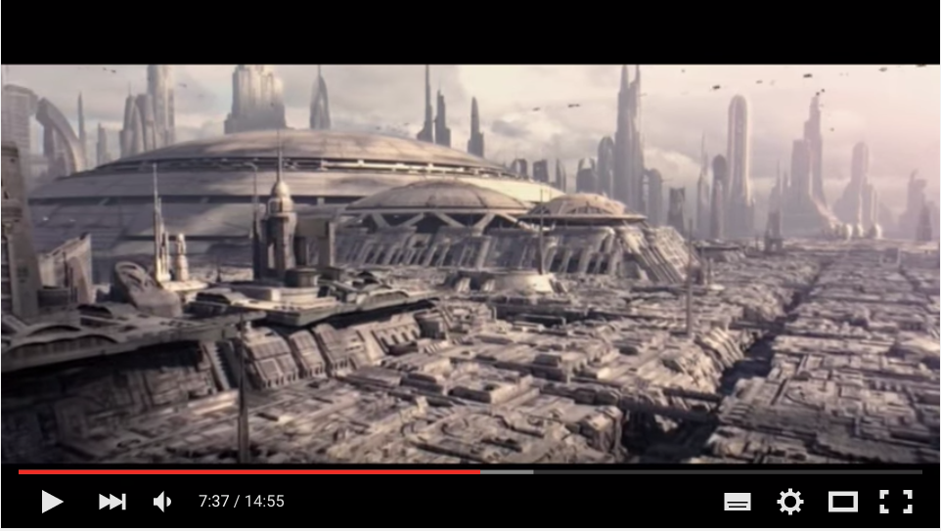



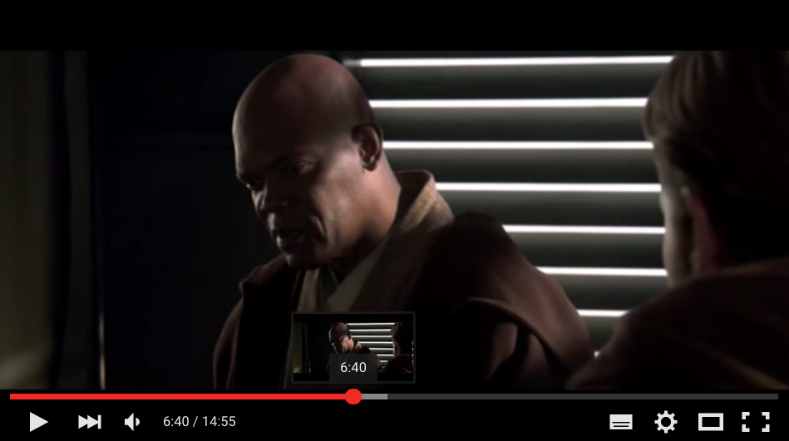

Generator
~ composition of video sequences
video variants

Slide 16
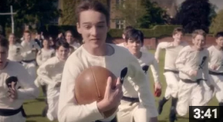
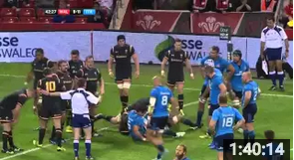
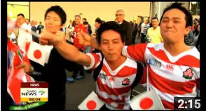
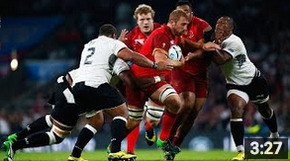
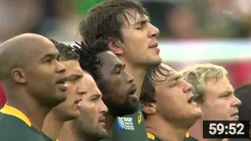

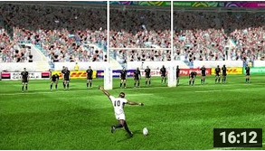
Generator
~ composition of video sequences
video variants

Slide 17
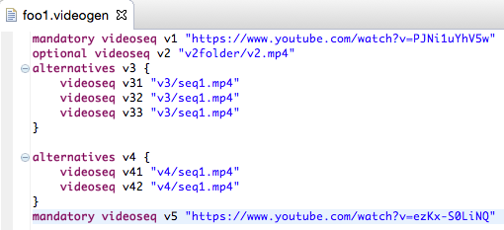
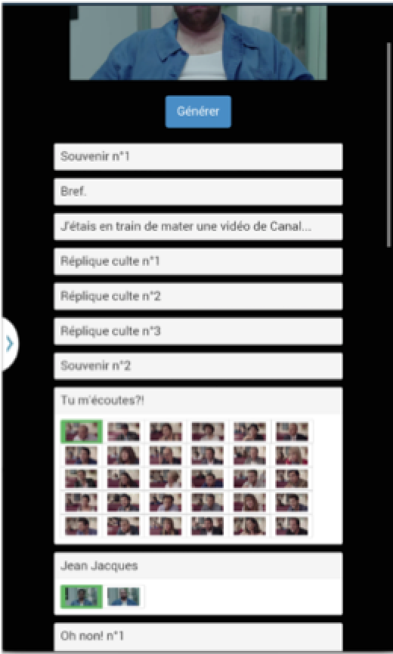
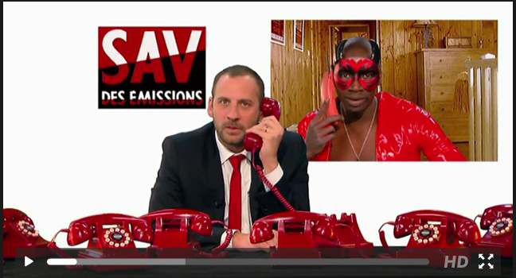
Website/online
Random generation
Configurator
Game
…

Slide 18
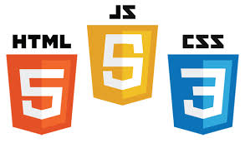






Slide 19
#1 How to design, create, and support dedicated languages (DSLs)?
#2 How to transform models/programs?
#3 How to manage variability/variants?
#4 How do frameworks internally work?

Slide 20
Xtext, a popular, easy-to-use model-based tool
for developping DSLs
Your DSL in 5’ (incl. editors and serializers)

Slide 21
Your DSL in 5’
Short Demonstration

Slide 22
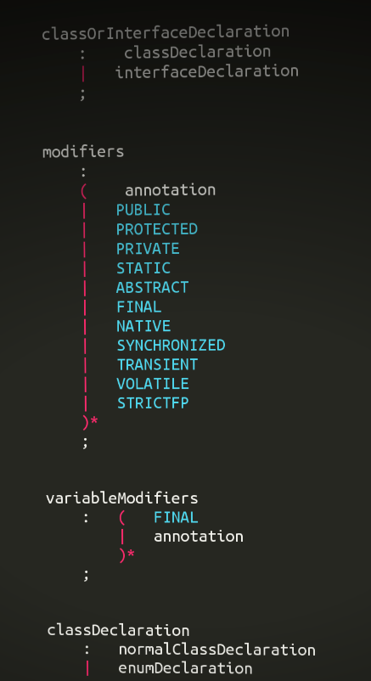
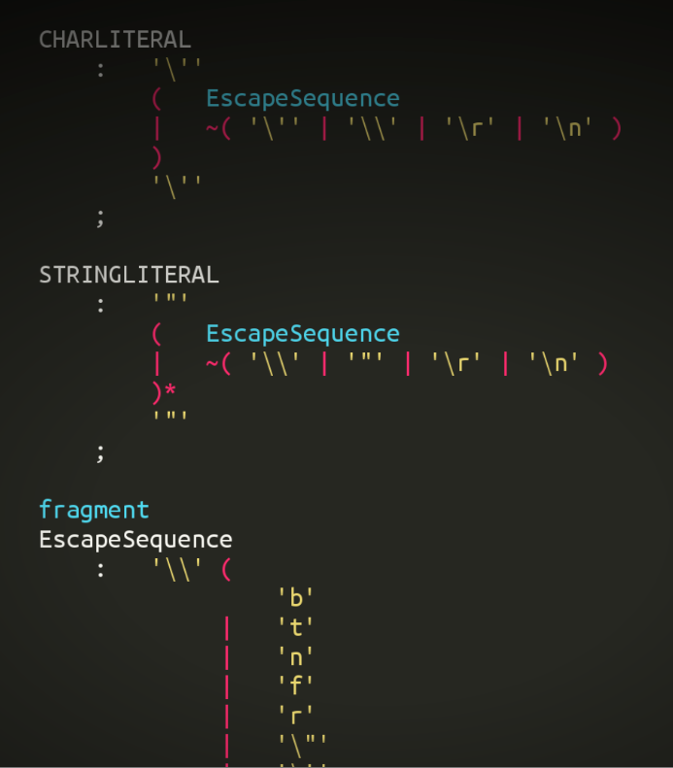
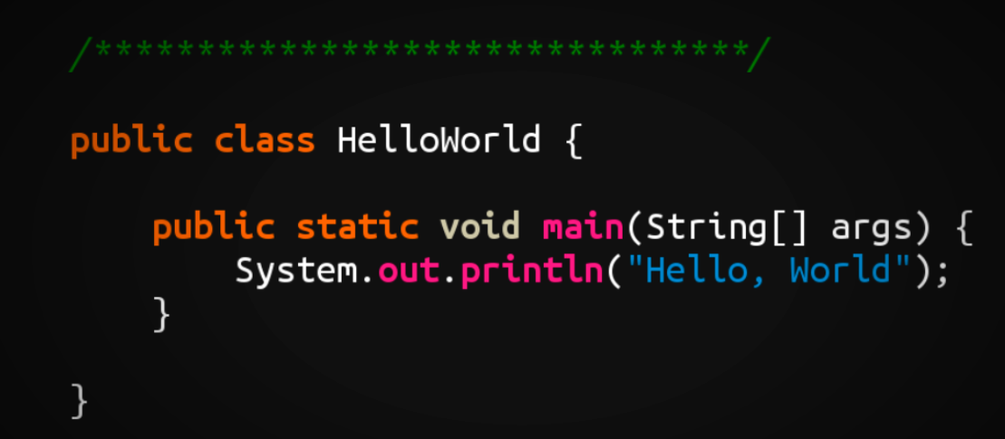
Foundations (or some course refresh)
M³
Java Grammar
EBNF
Grammar
M²
Java Program
M¹
Source
Code

Slide 23
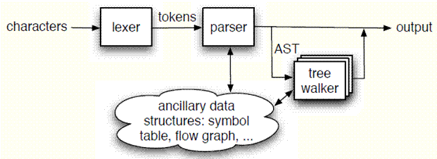
Compilation Process
Source code
Concrete syntax used for specifying a program
Conformant to a grammar
Lexical analysis
Conveting a sequence of characters into a sequence of tokens
Parsing (Syntactical analysis)
Abtsract Syntax Tree (AST)

Slide 24
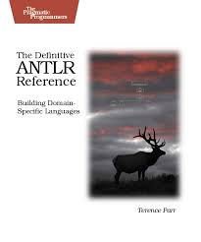


Slide 25
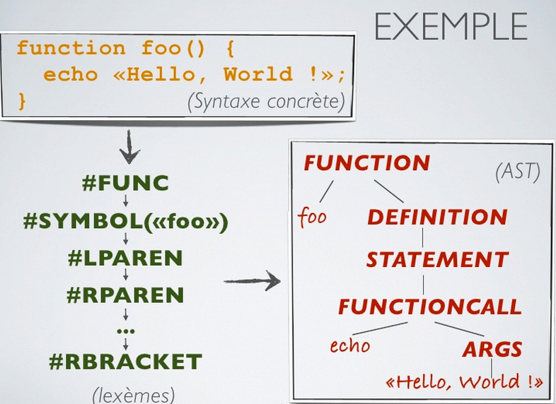

Slide 26
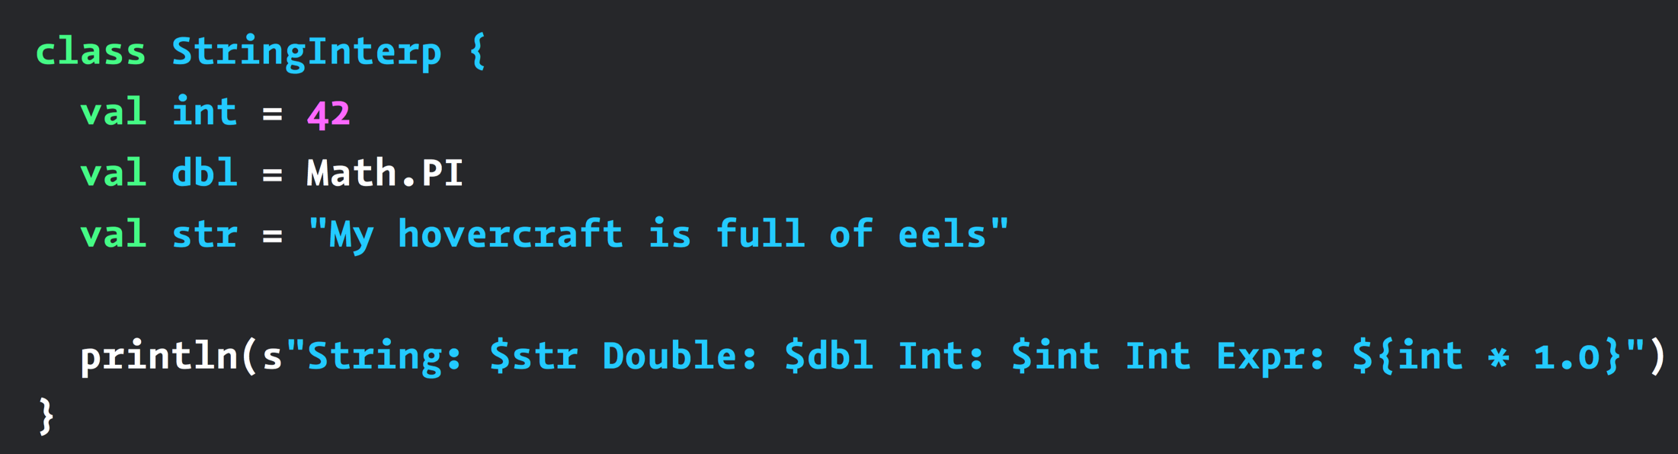
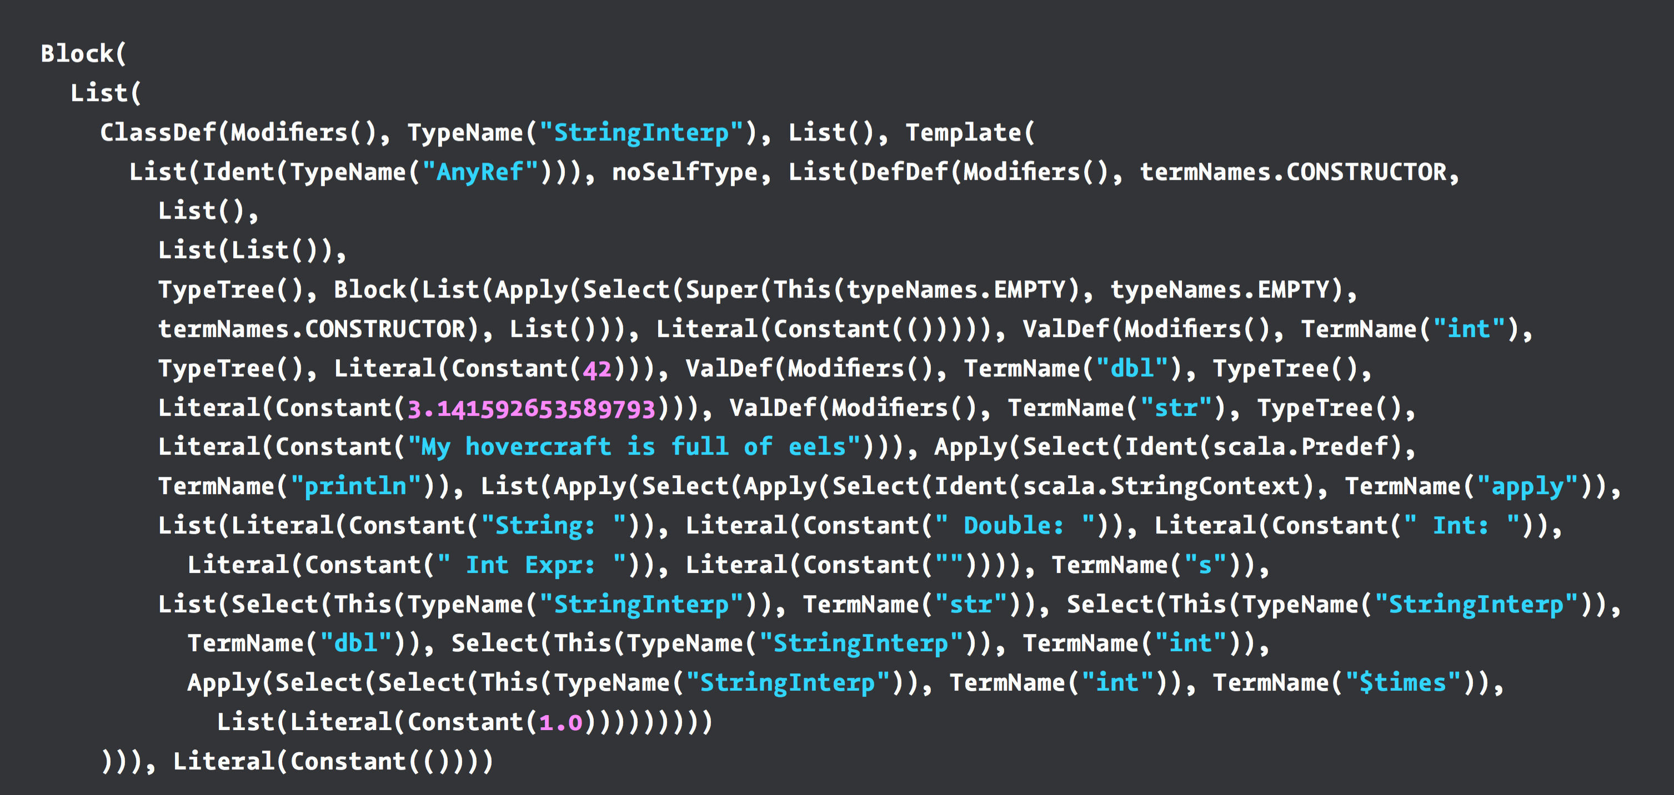
Scala AST
(example)

Slide 27
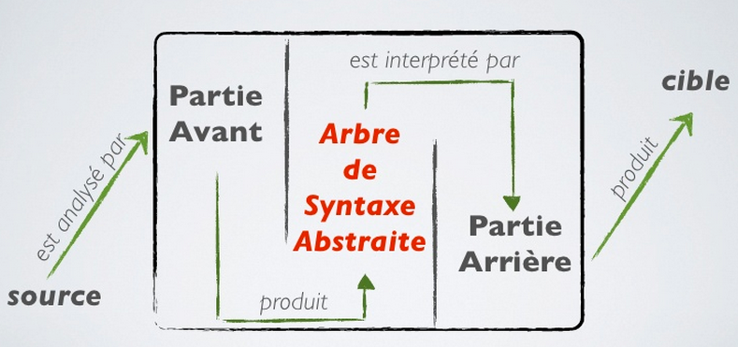
Compilation (en français)

Slide 28
DSL? The same!
M³
EBNF
Grammar
M²
DSL Grammar
DSL specification/program
M¹
Source
Code

Slide 30
M³
EBNF
Metametamodel
Grammar
Metamodel
M²
M¹
Source
Code
Model

Slide 31
Language and MDE
Grammar
Metamodel
conforms To
conforms To
Source Code
A
Source Code
C
Model A
Model C
Source Code
B
Model B
Grammarware
Modelware

Slide 32
Give me a grammar,
I’ll give you (for free)
* a comprehensive editor (auto-completion, syntax highlitening, etc.) in Eclipse
* an Ecore metamodel and facilities to load/serialize/visit conformant models (Java ecosystem)
* extension to override/extend « default » facilities (e.g., checker)

Slide 33
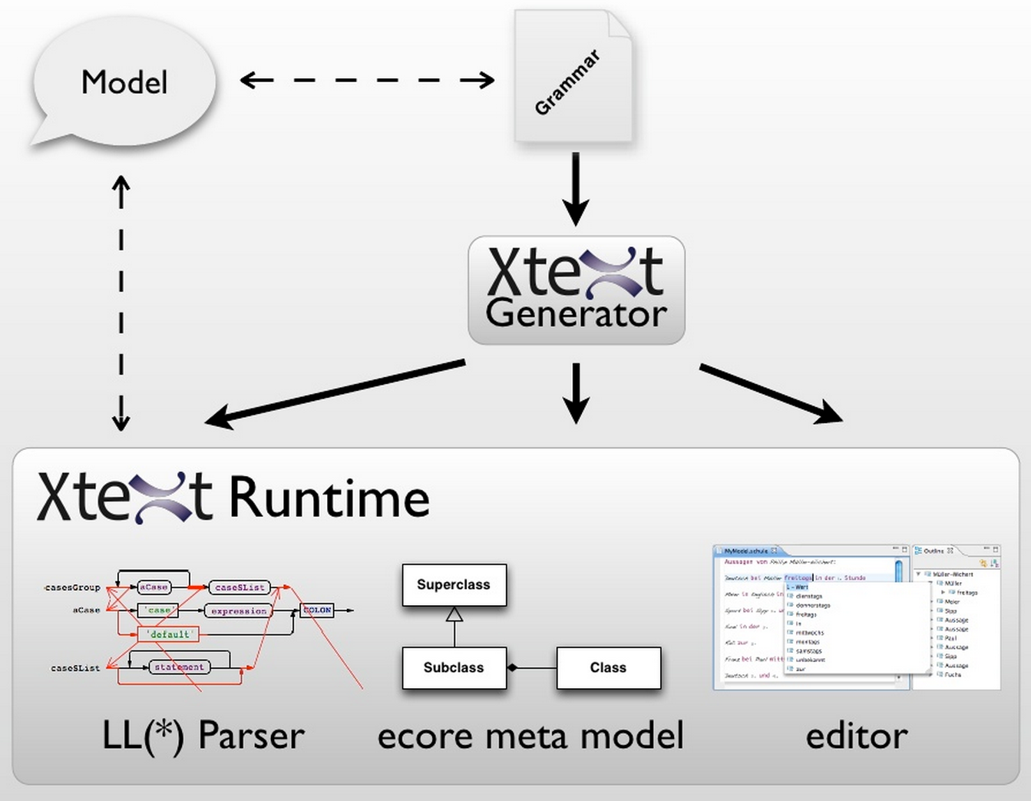

Slide 34

Xtext, Grammar, Metamodel
Xtext, Grammar, Metamodel
Grammar
Metamodel
conforms To
conforms To
Source Code
A
Model A

Slide 35
Xtext
Xtext Project
Eclipse Project
Part of Eclipse Modeling
Part of Open Architecture Ware
Model-driven development of Textual DSLs
Part of a family of languages
Xtext
Xtend
Xbase
Xpand
Xcore

Slide 36
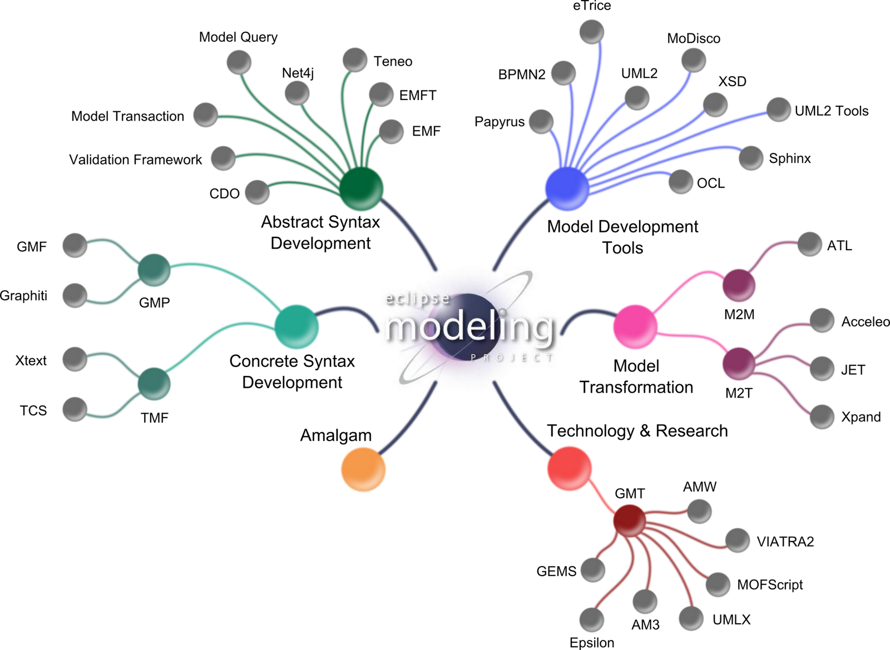
Eclipse Modeling Project

Slide 37
The grammar language
The Grammar Language of Xtext
Corner-stone of Xtext
A… DSL to define textual languages
Describe the concrete syntax
Specify the mapping between concrete syntax and domain model
From the grammar, it is generated:
The domain model
The parser
The tooling

Slide 38
Main Advantages
Consistent look and feel
Textual DSLs are a resource in Eclipse
Open editors can be extended
Complete framework to develop DSLs
Easy to connect to any Java-based language

Slide 39
Development Process
Create Xtext Project
Defining the DSL
Grammar definition
Workflow definition
Configure Fomatting (opt)
Configure Scoping (opt)
Generate DSL tooling
Configure validation (opt)
Configure generator
OPTIONAL

Slide 40



Example DSL
A first example
Poll System application
Define a Poll with the corresponding questions
Each question has a text and a set of options
Each option has a text
Generate the application in different platforms
DSL Tooling
Poll System Definition
Generator

Slide 41
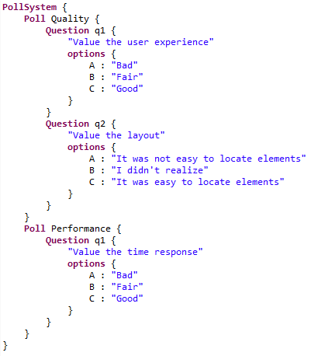
Something like…
DSL Tooling
Generator

Slide 42
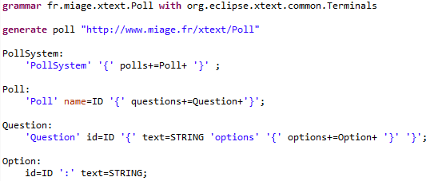
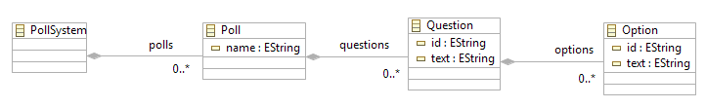
Xtext Grammar
Grammar
definition

Slide 43
Xtext Grammar
Grammar
reuse

Slide 44
Xtext Grammar
Derived
metamodel

Slide 45
Xtext Grammar
Parser Rules

Slide 46
Xtext Grammar
Keywords

Slide 47
Xtext Grammar
Multivalue asignment
Simple asignment
(not here ➔ ?= Boolean asignment)

Slide 48
Xtext Grammar
Cardinality (others: * ?)

Slide 49
Xtext Grammar
Containment

Slide 50
Grammar and Programs/Specifications/Models

Slide 51
Grammar and Programs/Specifications/Models

Slide 52
Grammar and Programs/Specifications/Models

Slide 53
Grammar and Programs/Specifications/Models

Slide 54
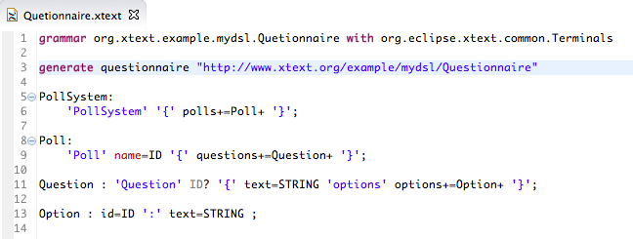
Quizz Time
Est-ce que le fichier vide .q est correct vis-à-vis de la grammaire Xtext? Pourquoi?

Slide 55
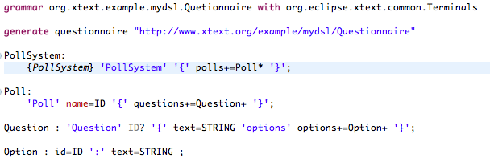
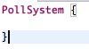
Quizz Time
Est-ce que le fichier.q suivant est correct vis-à-vis de la grammaire Xtext? Pourquoi?

Slide 56
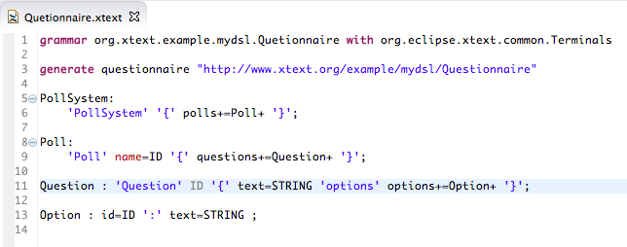
Quizz Time
PollSystem {
Poll p1 {
Question {
"Q1"
options o1 : "R1"
}
}
}
Est-ce que le fichier.q suivant est correct vis-à-vis de la grammaire Xtext? Pourquoi?

Slide 57
Xtext, your DSL in 5’ (incl. editors and serializers)
Live Demonstration

Slide 58
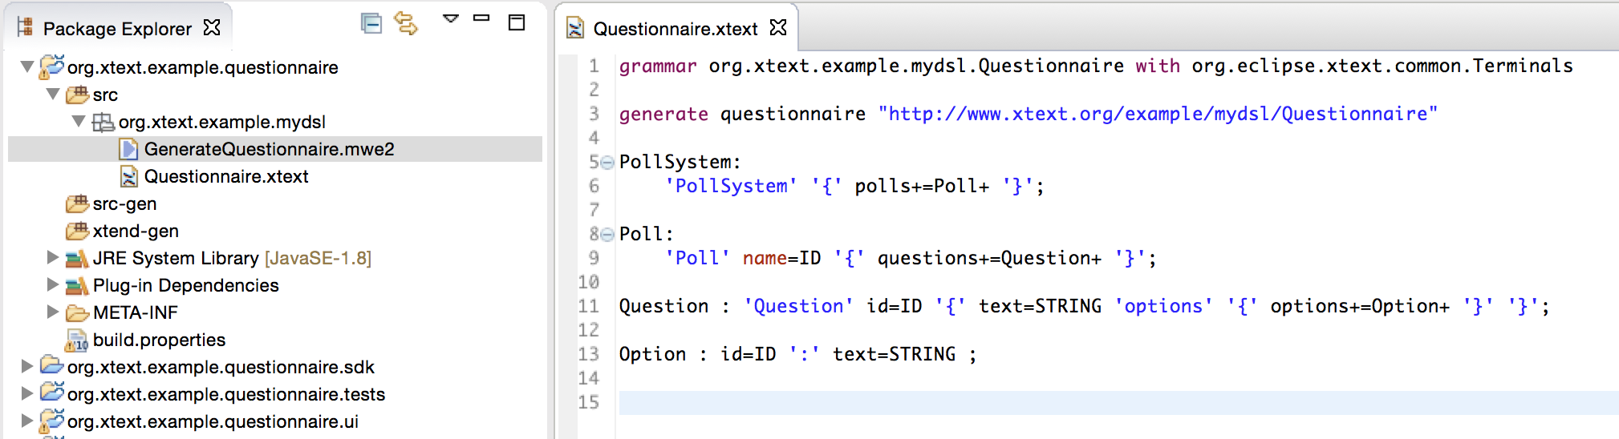

Slide 59
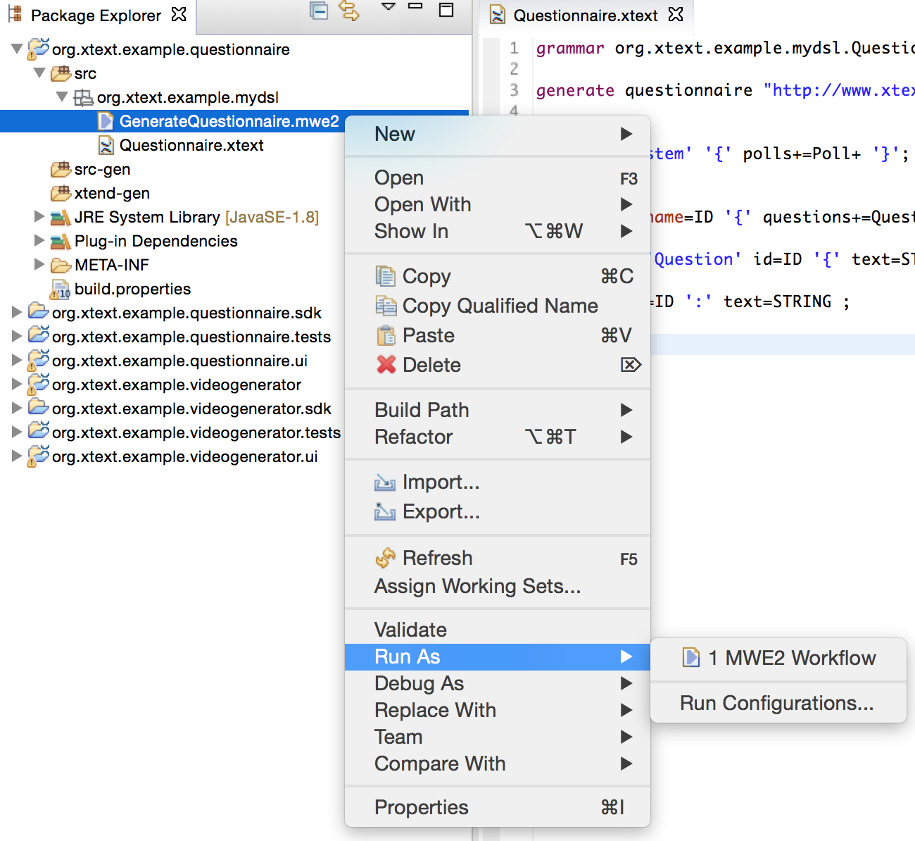

Slide 60
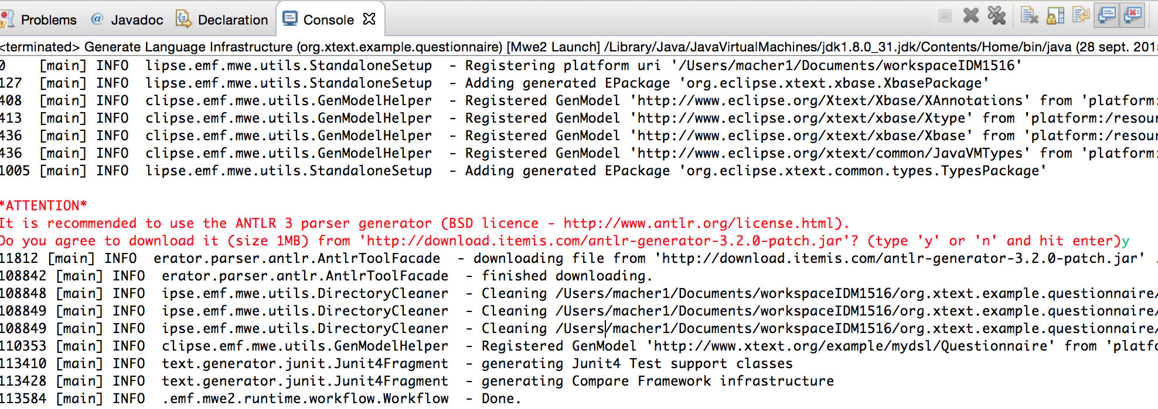

Slide 61
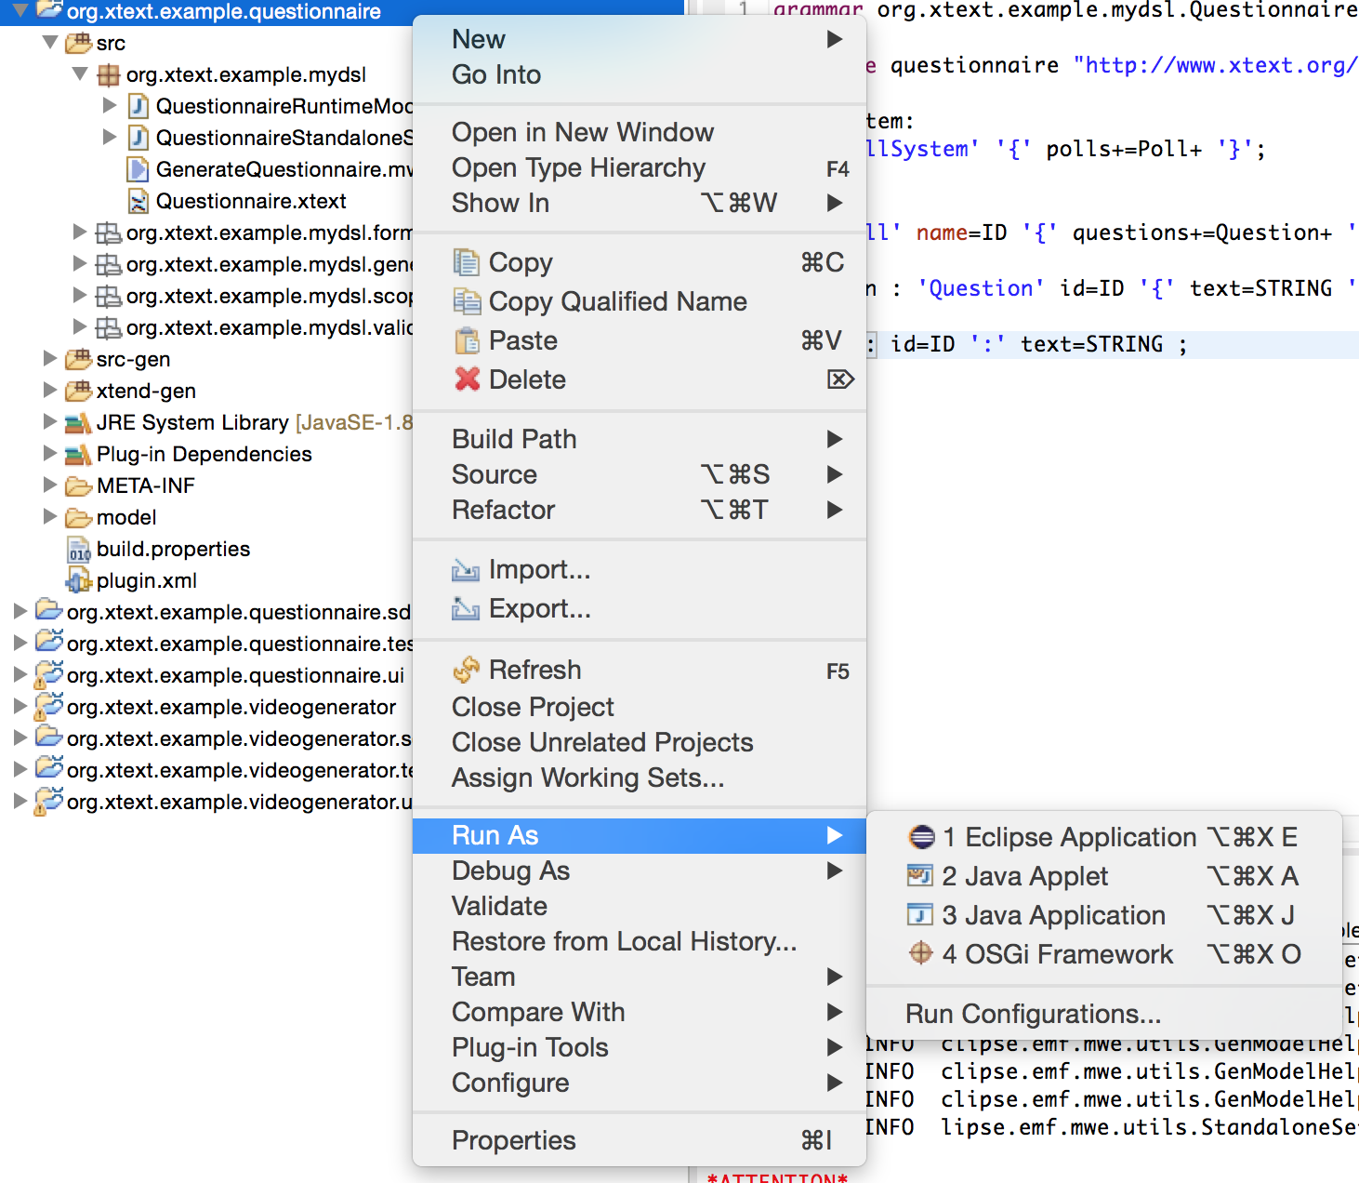

Slide 62
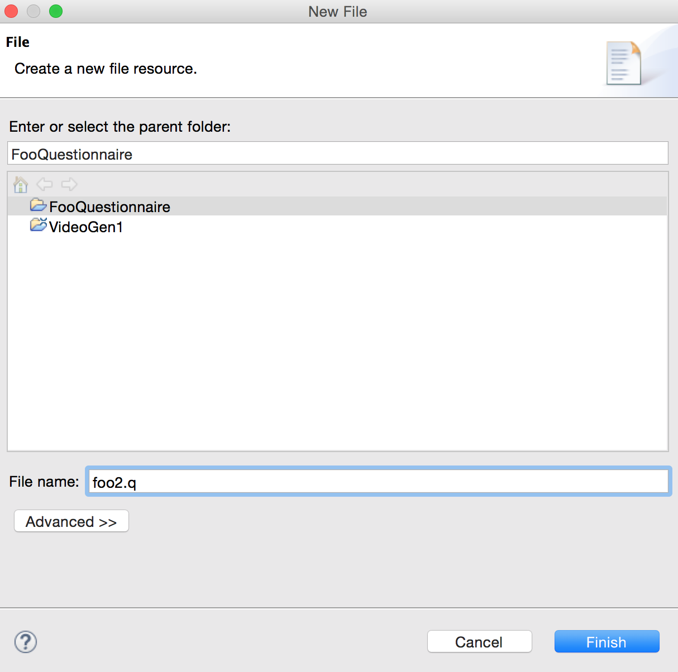

Slide 63
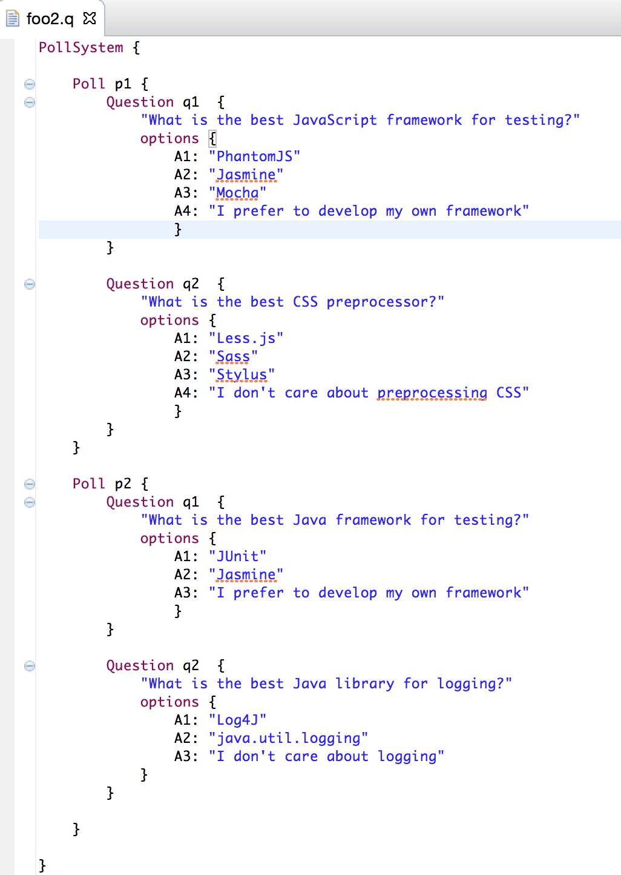

Slide 64
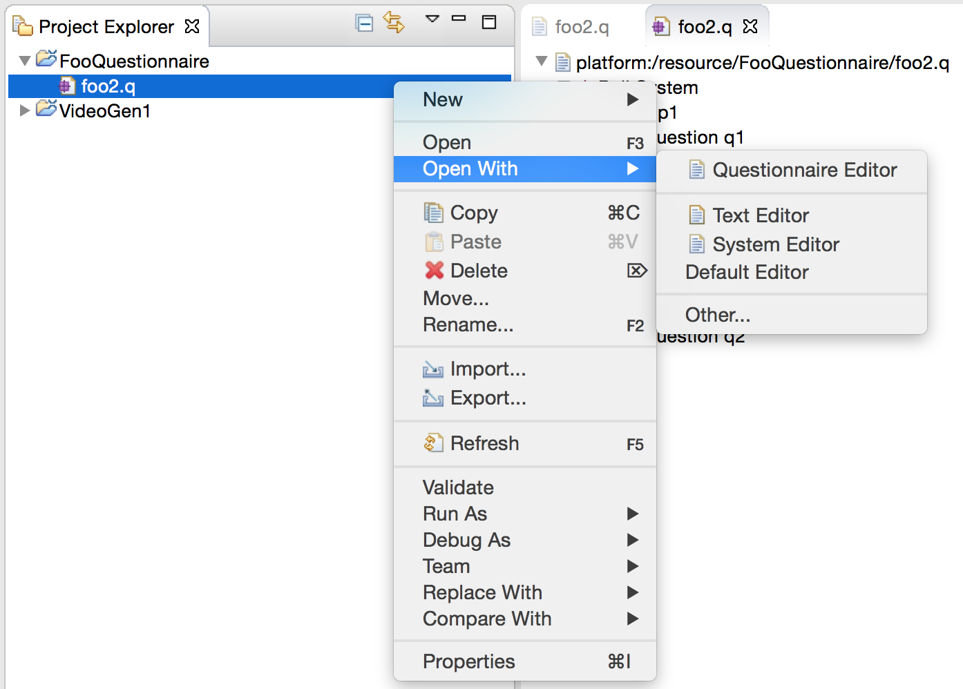
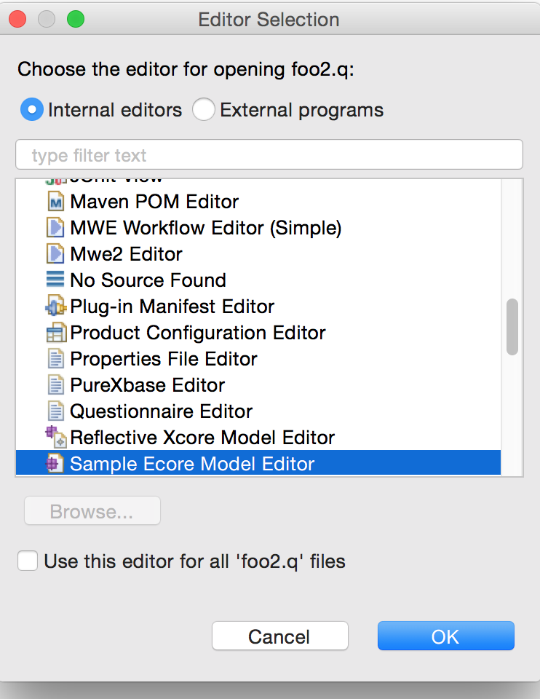

Slide 65


Slide 66


Slide 67



Slide 68
Another example:
Chess

Slide 69


Slide 70


Slide 71


Slide 72


Slide 73
Chess Example - Grammar
Game:
"White:" whitePlayer=STRING
"Black:" blackPlayer=STRING
(moves+=Move)+;
Move:
AlgebraicMove | SpokenMove;
AlgebraicMove:
(piece=Piece)? source=Square (captures?='x'|'-') dest=Square;
SpokenMove:
piece=Piece 'at' source=Square
(captures?='captures' capturedPiece=Piece 'at' | 'moves to')
dest=Square;
terminal Square:
('a'..'h')('1'..'8');
enum Piece:
pawn = 'P' | pawn = 'pawn' |
knight = 'N' | knight = 'knight' |
bishop = 'B' | bishop = 'bishop' |
rook = 'R' | rook = 'rook' |
queen = 'Q' | queen = 'queen' |
king = 'K' | king = 'king';

Slide 74
Chess Example - Model
White: "Mayfield"
Black: "Trinks“
pawn at e2 moves to e4
pawn at f7 moves to g5
K b1 - c3
f7 - f5
queen at d1 moves to h5
// 1-0

Slide 75
Back to Video
(VideoGen)

Slide 78
Quizz Time
Write a Xtext grammar so that the specification below is conformant

Slide 79
From Metamodel
To
Grammar (other side)

Slide 80
From Metamodel to Grammar
Grammar
Metamodel
conforms To
conforms To
Source Code A
Model A

Slide 81
Give me a metamodel,
I’ll give you (for free)
* a comprehensive editor (auto-completion, syntax highlitening, etc.) in Eclipse
* a grammar and facilities to load/serialize/visit conformant models (Java ecosystem)
* extension to override/extend « default » facilities (e.g., checker)

Slide 82
Give me a metamodel,
The grammar can be « weird » (i.e., not as concise and as comprehensible than if you made it manually)
[Same observation actually applies to the other side: generated metamodels (from grammar) can be weird as well, but you have at least some control in Xtext-based grammar]
[We will experiment in the lab sessions]

Slide 83
Live
Demonstration

Slide 84



Slide 85


Slide 86
Quizz Time
Explain (roughly) the « algorithm » of Xtext to generate a grammar from an ecore Metamodel

Slide 87
Graphical DSL
(vs Textual DSL)

Slide 88


Graphical vs. Textual DSLs
Graphical vs Textual DSLs
Success depends on how the notation fits the domain
class Person {
private String name;
private String name;
}
Person has (name, surname)
Person
name : string
surname : string
Graphical DSLs are not always easier to understand

Slide 89

A language can be
graphical and textual

Slide 90


Alternative representation

Slide 91

Recommendations
Recommendations for
Graphical DSLs

Slide 92
Recommendations
Recommendations for
Graphical DSLs
Physics of notations
Semiotic clarity
Perceptual Discriminality
Complexity Management
Semantics transparency
Cognitive Integration
Visual Expressiveness
Dual Coding
Graphic Economy
Cognitive Fit

Slide 93
Recommendations
Recommendations for
Graphical DSLs
Physics of notations
Semiotic clarity
Perceptual Discriminality
Complexity Management
Semantics transparency
Cognitive Integration
Visual Expressiveness
Dual Coding
Graphic Economy
Cognitive Fit
There should be a 1:1 correspondence between concepts and graphical symbols

Slide 94

Recommendations
Recommendations for
Graphical DSLs
Physics of notations
Semiotic clarity
Perceptual Discriminality
Complexity Management
Semantics transparency
Cognitive Integration
Visual Expressiveness
Dual Coding
Graphic Economy
Cognitive Fit

Slide 95
Recommendations
Recommendations for
Graphical DSLs
Physics of notations
Semiotic clarity
Perceptual Discriminality
Complexity Management
Semantics transparency
Cognitive Integration
Visual Expressiveness
Dual Coding
Graphic Economy
Cognitive Fit
Different symbols should be clearly distinguishable from each other

Slide 96

Recommendations
Recommendations for
Graphical DSLs
Physics of notations
Semiotic clarity
Perceptual Discriminality
Complexity Management
Semantics transparency
Cognitive Integration
Visual Expressiveness
Dual Coding
Graphic Economy
Cognitive Fit

Slide 97
Recommendations for
Graphical DSLs
Physics of notations
Semiotic clarity
Perceptual Discriminality
Complexity Management
Semantics transparency
Cognitive Integration
Visual Expressiveness
Dual Coding
Graphic Economy
Cognitive Fit
Use visual representations whose apprarance suggests their meaning

Slide 98
Recommendations
Recommendations for
Graphical DSLs
Physics of notations
Semiotic clarity
Perceptual Discriminality
Complexity Management
Semantics transparency
Cognitive Integration
Visual Expressiveness
Dual Coding
Graphic Economy
Cognitive Fit
Include mechanisms for dealing with complexity

Slide 99
Recommendations
Recommendations for
Graphical DSLs
Physics of notations
Semiotic clarity
Perceptual Discriminality
Complexity Management
Semantics transparency
Cognitive Integration
Visual Expressiveness
Dual Coding
Graphic Economy
Cognitive Fit
Include explicit mechanisms to support integration of information from different diagrams

Slide 100
Recommendations
Recommendations for
Graphical DSLs
Physics of notations
Semiotic clarity
Perceptual Discriminality
Complexity Management
Semantics transparency
Cognitive Integration
Visual Expressiveness
Dual Coding
Graphic Economy
Cognitive Fit
Use the full range and capacities of visual variables

Slide 101

Recommendations for
Graphical DSLs
Physics of notations
Semiotic clarity
Perceptual Discriminality
Complexity Management
Semantics transparency
Cognitive Integration
Visual Expressiveness
Dual Coding
Graphic Economy
Cognitive Fit

Slide 102


Recommendations
Recommendations for
Graphical DSLs
Physics of notations
Semiotic clarity
Perceptual Discriminality
Complexity Management
Semantics transparency
Cognitive Integration
Visual Expressiveness
Dual Coding
Graphic Economy
Cognitive Fit

Slide 103

Recommendations
Recommendations for
Graphical DSLs
Physics of notations
Semiotic clarity
Perceptual Discriminality
Complexity Management
Semantics transparency
Cognitive Integration
Visual Expressiveness
Dual Coding
Graphic Economy
Cognitive Fit

Slide 104
Recommendations
Recommendations for
Graphical DSLs
Physics of notations
Semiotic clarity
Perceptual Discriminality
Complexity Management
Semantics transparency
Cognitive Integration
Visual Expressiveness
Dual Coding
Graphic Economy
Cognitive Fit
Use text to complement graphics

Slide 105

Recommendations
Recommendations for
Graphical DSLs
Physics of notations
Semiotic clarity
Perceptual Discriminality
Complexity Management
Semantics transparency
Cognitive Integration
Visual Expressiveness
Dual Coding
Graphic Economy
Cognitive Fit

Slide 106
Recommendations
Recommendations for
Graphical DSLs
Physics of notations
Semiotic clarity
Perceptual Discriminality
Complexity Management
Semantics transparency
Cognitive Integration
Visual Expressiveness
Dual Coding
Graphic Economy
Cognitive Fit
The number of different graphical symbols should be cognitively manageable

Slide 107
Recommendations
Recommendations for
Graphical DSLs
Physics of notations
Semiotic clarity
Perceptual Discriminality
Complexity Management
Semantics transparency
Cognitive Integration
Visual Expressiveness
Dual Coding
Graphic Economy
Cognitive Fit
Use different visual dialects for different tasks and audiences

Slide 108

Graphical Modeling Framework (GMF)
Model-Driven Framework to develop graphical editors based on EMF and GEF
GMF is part of Eclipse Modeling Project
Provides a generative component to create the DSL tooling
Provides a runtime infrastructure to facilitate the development of graphical DSLs

Slide 109

GMF
GMF
Eclipse project
Eclipse Modelling components
Uses
EMF (Eclipse Modeling Framework)
GEF (Graphical Editing Framework)
Model-driven framework for Graphical DSLs
Everything is a model
DSL definition easy, tweaking hard

Slide 110
Eclipse Modeling Project
Eclipse Modeling Project

Slide 111
Parts of GMF
GMF features
Tooling
Editors for notation, semantic and tooling
GMF Dashboard
Generator to produce the DSL implementation
Runtime
Generated DSLs depend on the GMF Runtime to produce an extensible graphical editor

Slide 112
Main advantages
Main Advantages
Consistent look and feel
Diagram persistence
Open editors can be extended by third-parties
Already integrated with various Eclipse components
Extensible notation metamodel to enable the isolation of notation from semantic concerns
Future community enhancements will easily be integrated

Slide 113
Development Process
Create GMF Project
Defining the DSL
Domain Model
Graphical Definition
Tooling Definition
Develop Mapping Model
Create Generator Model
Generate Diagram Plugin

Slide 114
Proposed development process
Development Process

Slide 115

Example DSL
Example (Graphical Notation)

Slide 116

Domain Model
Poll System Metamodel
Concepts
PollSystem
Poll
Question
Option
Attributes
A Poll has a name
A Question has an identifier and a descriptive text
An Option has an identifier and a descriptive text
Relationships
PollSystem is composed of polls and questions
Question has a set of options

Slide 117


Graphical Definition
Graphical Definition
A model will represent a PollSystem
A Poll will be a node
A Question will be a rectangular node
An Option will be a rectangular node included in the Question node

Slide 118
Plan
Domain-Specific Languages (DSLs)
Languages and abstraction gap
Examples and rationale
DSLs vs General purpose languages, taxonomy
External DSLs
Grammar and parsing
Xtext
DSLs, DSMLs, and (meta-)modeling

Slide 119
Contract
Better understanding/source of inspiration of software languages and DSLs
Revisit of history and existing languages
Foundations and practice of Xtext
State-of-the-art language workbench (Most Innovative Eclipse Project in 2010, mature and used in a variety of industries)
Models and Languages
Perhaps a more concrete way to see models, metamodels and MDE (IDM in french)

Slide 120
DSL,
Model,
Metamodel,
Summary

Slide 121










Abstraction Gap

Slide 122
Models/MDE
In essence, a model is an abstraction of some aspect of a system under study.
Some details are hidden or removed to simplify and focus attention.
A model is an abstraction since general concepts can be formulated by abstracting common properties of instances or by extracting common features from specific examples
(Domain-specific) Languages enable the specification or execution of models

Slide 123
Generative approach
Programming the generation of programs
Very old practice
Metaprogramming: generative language and target language are the same
Reflection capabilities
Generalization of this idea:
from a specification written in one or more textual or graphical domain-specific languages
you generate customized variants

Slide 124

Grammar
MetaModel
machineDefinition:
MACHINE OPEN_SEP stateList
transitionList CLOSE_SEP;
stateList:
state (COMMA state)*;
state:
ID_STATE;
transitionList:
transition (COMMA transition)*;
transition:
ID_TRANSITION OPEN_SEP
state state CLOSE_SEP;
MACHINE: ‘machine’;
OPEN_SEP: ‘{’;
CLOSE_SEP: ‘{’;
COMMA: ‘,’;
ID_STATE: ‘S’ ID;
ID_TRANSITION: ‘T’ (0..9)+;
ID: (a..zA..Z_) (a..zA..Z0..9)*;
conforms To
^{conforms To}
machine {
SOne STwo
T1 { SOne STwo }
}
Source Code/Model

Slide 125

Model, Metamodel, Metametamodel, DSML

Slide 126
M³
EBNF
Metametamodel
Grammar
Metamodel
M²
M¹
Source
Code
Model

Slide 127
Language and MDE
Language and MDE
Grammar
Metamodel
conforms To
conforms To
Source Code
A
Source Code
C
Model A
Model C
Source Code
B
Model B
Grammarware
Modelware

Slide 128
MDE, Grammar: there and back again
Grammar
Metamodel
conforms To
conforms To
Source Code B
Model A

Slide 129


« Domain-specific languages are far more prevalent than anticipated »
2011

Slide 130

What are models used for?
“Do not use” percentages for MDE activities

Slide 131

Which modeling languages do you use?
UML
BPMN
Vendor
DSL
In-house
DSL
SysML
Matlab/
Simulink

Slide 132

Which diagrams are used?
19 different diagram types are used regularly

Slide 133
Use of multiple languages (DSLs)
62% of those using custom DSLs also use UML
Almost all users of SysML and BPMN also use UML
UML is the most popular ‘single use’ language
38% of all respondents
UML used in combination with just about every combination of modeling languages
14% of UML users combine with vendor DSL
6% with both custom and vendor DSL
Notes:
Pragmatism prevails!

Slide 134








UML can be seen as a collection of domain-specific modeling languages
Structural
Behavioral

Slide 135
Xtext is built using MDE technologies
Xtext (and alternatives) democratize DSL development

Slide 136
My 3 take away messages
#1 DSLs are important (as intuited for a long time – it will become more and more apparent)
#2 DSL technology is here (no excuse)
#3 MDE meets language engineering

Slide 137
But my take away message is NOT
That DSLs should be used systematically, in every situations

Slide 138
Worst practices
When Developing DSLs?
Tradeoff cost/time of development versus producivity gained for solving problems
If you use your DSL for resolving one problem, just one time, hum…
DSL: reusable, systematic means to resolve a specific task in a given domain
DSL development can pay off quickly
5’ you can get a DSL
But DSL development can be time-consuming and numerous worst practices exists

Slide 139

Actors
Actors

Slide 140
Actors
Actors
High
Domain Knowledge
Low
Low
Technical Level
High

Slide 141
Best practices
Best Practices
Limit Expressiveness
Tooling
Support
Learn from GPLs
Evolution
Viewpoints

Slide 142
Worst practices
Worst Practices
Initial conditions
Only Gurus allowed
Believe that only gurus can build languages ir that “I’m smart and don’t need help”
Lack of Domain Understanding
Insufficiently understanding the problem domain or the solution domain
Analysis paralysis
Wanting the language to be theoretically complete, with its implementation assured

Slide 143
Worst practices
Worst Practices
The source for Language Concepts
UML: New Wine in Old Wineskins
Extending a large, general-purpose modeling language
3GL Visual Programming
Duplicanting the concepts and semantics of traditional programming languages
Code: The Library is the Language
Focusing the language on the current code’s technical details
Tool: if you have a hammer
Letting the tool’s technical limitations dictate language development

Slide 144
Worst practices
Worst Practices
The resulting language
Too Generic / Too Specific
Creating a language with a few generic concepts or too many specific concepts, or a language that can create only a few models
Misplaced Emphasis
Too strongly emphasizing a particular domain feature
Sacred at Birth
Viewing the initial language version as unalterable

Slide 145
Worst practices
Worst Practices
Language Notation
Predetermined Paradigm
Choosing the wrong representational paradigm or the basis of a blinkered view
Simplistic Symbols
Using symbols that are too simple or similar or downright ugly

Slide 146
Worst practices
Worst Practices
Language Use
Ignoring the use process
Failing to consider the language’s real-life usage
No training
Assuming everyone understands the language like its creator
Pre-adoption Stagnation
Letting the language stagnate after successful adoption

Slide 147
Questions ?
(see also resources and lab sessions)

Slide 148

http://martinfowler.com/bliki/DomainSpecificLanguage.html

Slide 149
References
Martin Fowler. Domain Specific Languages. Addison-Wesley Professional, 2010.
Markus Voelter et al. “DSL Engineering: Designing, Implementing and Using Domain-Specific Languages.” dslbook.org, 2013.
Sven Efftinge, Moritz Eysholdt, Jan Köhnlein, Sebastian Zarnekow, Robert von Massow, Wilhelm Hasselbring, and Michael Hanus. Xbase: Implementing domain-specific languages for java. GPCE ’12
Steven Kelly and Risto Pohjonen. Worst practices for domain-specific modeling. IEEE Software, 26(4):22–29, 2009.
Lennart C.L. Kats and Eelco Visser. The spoofax language workbench: Rules for declarative specification of languages and ides OOPSLA’10

Slide 150
References
Sebastian Erdweg, Tijs van der Storm, Markus Völter, Meinte Boersma, Remi Bosman, William R. Cook, Albert Gerritsen, Angelo Hulshout, Steven Kelly, Alex Loh, Gabriël D. P. Konat, Pedro J. Molina, Martin Palatnik, Risto Pohjonen, Eugen Schindler, Klemens Schindler, Riccardo Solmi, Vlad A. Vergu, Eelco Visser, Kevin van der Vlist, Guido Wachsmuth, and Jimi van der Woning. The state of the art in language workbenches conclusions from the language workbench challenge. SLE’13
Steven Kelly, Kalle Lyytinen, Matti Rossi, and Juha-Pekka Tolvanen. Metaedit+ at the age of 20. In Seminal Contributions to Information Systems Engineering, pages 131–137. Springer, 2013.
Sebastian Erdweg, Tillmann Rendel, Christian Kästner, and Klaus Ostermann. Sugarj: Library-based syntactic language extensibility. OOPSLA’11

